Slide 1
An improved workflow for MCMC in Stock Synthesis assessments
Cole Monnahan
Virtual workshop
2021-03-08
cole.monnahan@noaa.gov

Slide 2
Road map for today
Setup your models to work with ‘adnuts’ R package
Integrate them with default algorithm (RWM)
Examine MCMC convergence diagnostics
Examine model diagnostics (parameterization issues)
Interspersed with:
Theory, discussions, questions, extensions

Slide 3
Setting up the model for MCMC
Work with a copy of main assessment folder/files
All input/output files go in a dedicated folder
Prefer simple, short names e.g.‘flathead’,‘mcmc’, ‘fhs_mcmc’
Suggest placing R script *one level above this folder*
This folder will be copied for each chain.

Slide 4
Setting up the model for MCMC
Eliminate printing updates to console
Eliminate unnecessary calculations, e.g., if(sd_phase() &! mc_phase()){
Find_F35();
Find_OFL();
}
sd_phase()=TRUE during MCMC!!

Slide 5
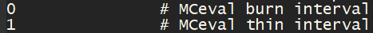
Special considerations for SS models
Step 1: Set starter file settings:
Step 2: Optimize with the flag –mcmc, because the posterior is different with/without this flag (due to recdev bias adjustment) ss –mcmc 100
But use version without ‘-mcmc’ for MLEs

Slide 6
[Demo setup in R and run tests;
Share value for thin30min in comments]

Slide 7
[Start chains so runs take about 30 minutes];

Slide 8
Quick introductions
Please write in the chat window:
What is your experience with MCMC in ADMB?
How much background on MCMC theory such as diagnostics, convergence etc.?
What other packages have you used? Have you used Stan?

Slide 9
Details of adnuts and sample_rwm
R package to give Stan-link capabilities for ADMB models
ADMB source code has random-walk Metropolis (RWM) alg.
This function is a wrapper to the ADMB call:
Uses output files from optimization for initial values (admodel.hes) and covariance matrix (admodel.cov).
This assumes a successfully optimized model

Slide 10
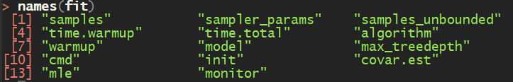
Details of adnuts and sample_rwm
Command run in main (serial) or temporary folder (parallel)
Then reads output files (.psv, rwm_lp.txt, etc.)
Chains merged together and formatted into R object useful for diagnostic packages [but rarely need to access it]

Slide 11
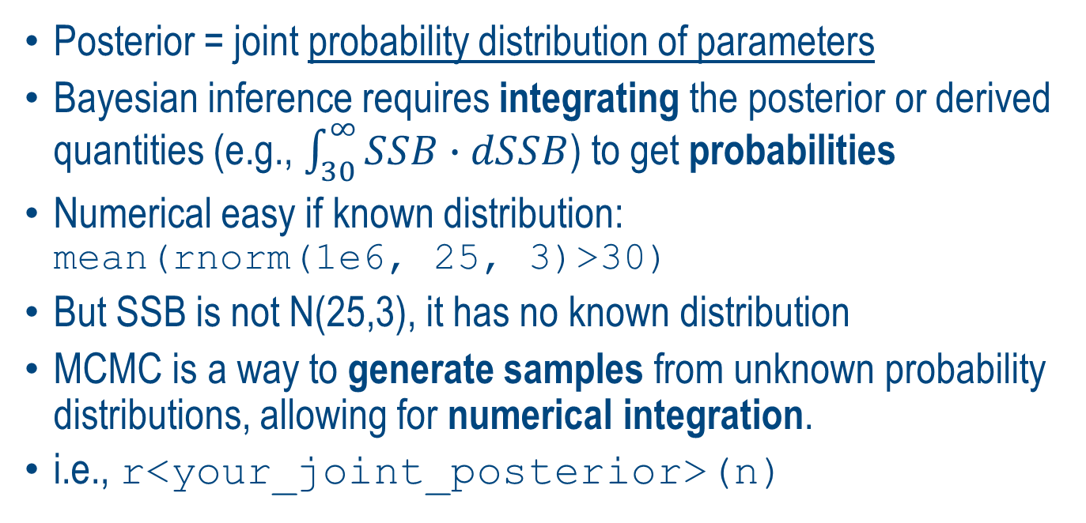
Bayesian inference & MCMC in a nutshell
Posterior = joint probability distribution of parameters
Bayesian inference requires integrating the posterior or derived quantities (e.g., $\int_{30}^{∞}{SSB∙dSSB}$) to get probabilities
Numerical easy if known distribution: mean(rnorm(1e6, 25, 3)>30)
But SSB is not N(25,3), it has no known distribution
MCMC is a way to generate samples from unknown probability distributions, allowing for numerical integration.
i.e., r<your_joint_posterior>(n)
Numerical integral: ≈Pr(SSB>30)
More samples → better approximation

Slide 12
Convergence diagnostics background
Autocorrelation is present by design (MCMC), and the higher it is, the more uncertain the estimates
The estimated effective sample size (ESS) quantifies this.
High ESS/(N samples) is good, is “fast” mixing
Each parameter has an ESS, so the min(ESS) is used
Want at least a few hundred minESS for real analyses
Rhat measures convergence issues (R>1.1 suggests not mixing); max(Rhat) is used
https://mc-stan.org/docs/2_25/reference-manual/convergence.html

Slide 13
Convergence diagnostics with ‘adnuts’
Fits with ‘adnuts’ automatically calculate key convergence diagnostics (via rstan): summary(fit) … Minimum ESS=4 (0.04%), and maximum Rhat=3.599
Very clear signs of non-convergence!
‘coda’ and ‘bayes_plot’ also can be used (see vignette(‘adnuts’) for examples)

Slide 14
Convergence diagnostics with ‘adnuts’
ShinyStan “provides visual and numerical summaries of model parameters and convergence diagnostics for MCMC simulations”
Accessible with adnuts: launch_shinyadmb(fit)
Works best with NUTS chains, but also for RWM used here
[Demo in R]
https://mc-stan.org/users/interfaces/shinystan

Slide 15
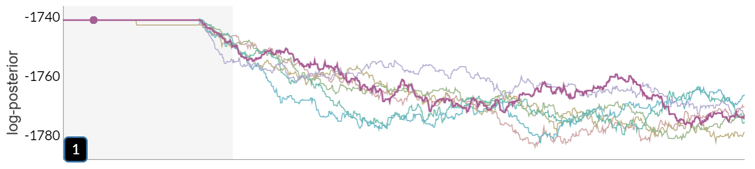
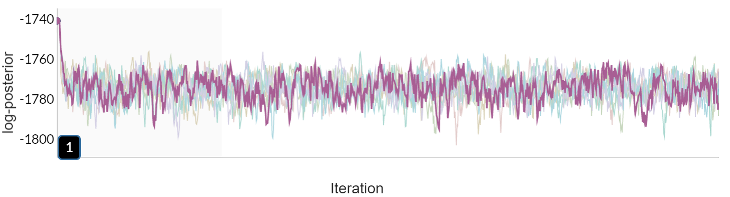
Initialized at mode
Flathead sole
Slowly move away
Thin=1; ESS=5; Rhat=2.2
Tuning in warmup
Sampling
Thin=50; ESS=220; Rhat=1.02
Rapid convergence to typical set
Typical set

Slide 16
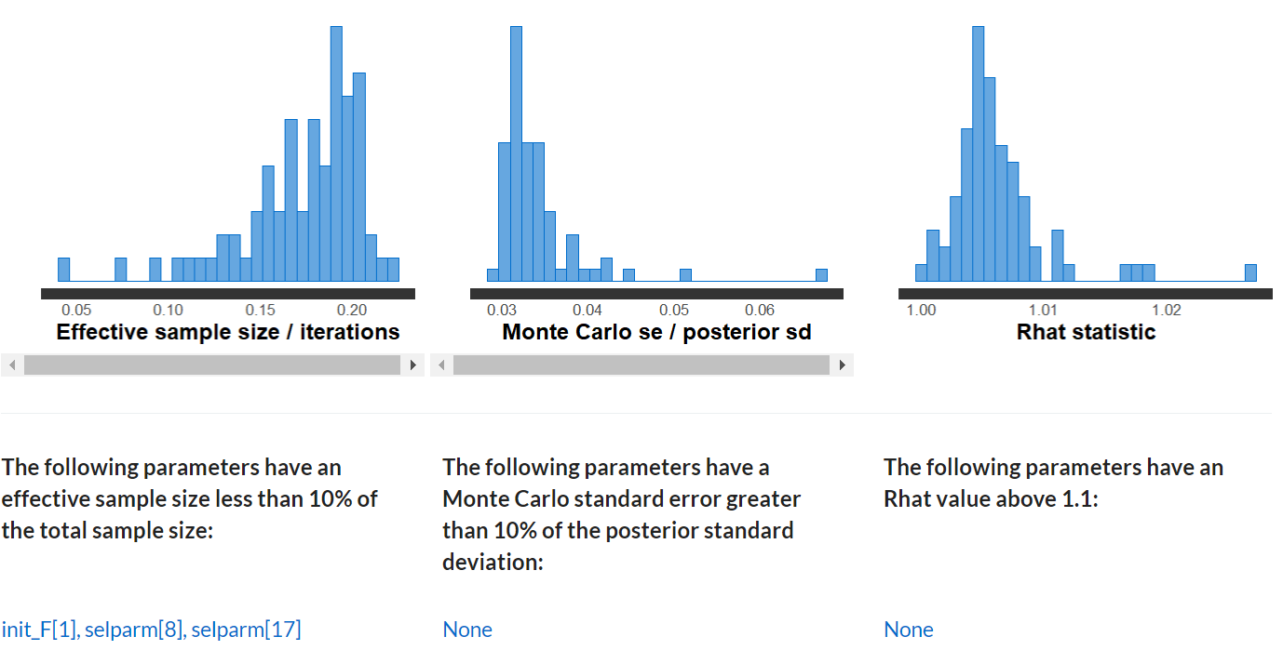
Flathead sole – looks much better after thin=50

Slide 17
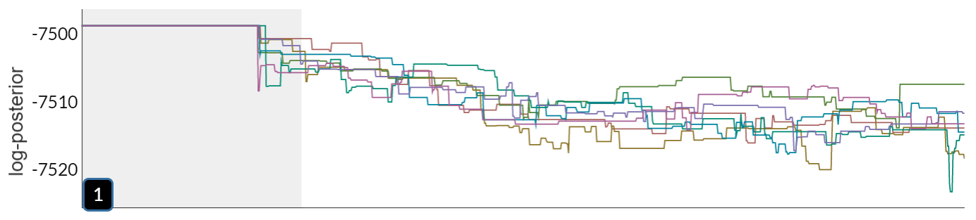
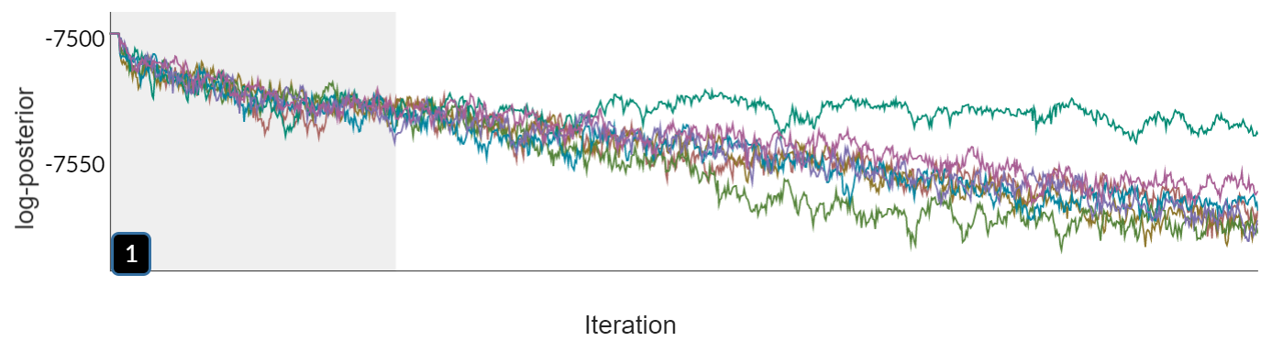
17
Snow crab
Thin=2; ESS=4; Rhat=3.6
Initialized at mode
Not converging to typical set
Thin=50; ESS=4; Rhat=3.7
Not at typical set!!

Slide 18
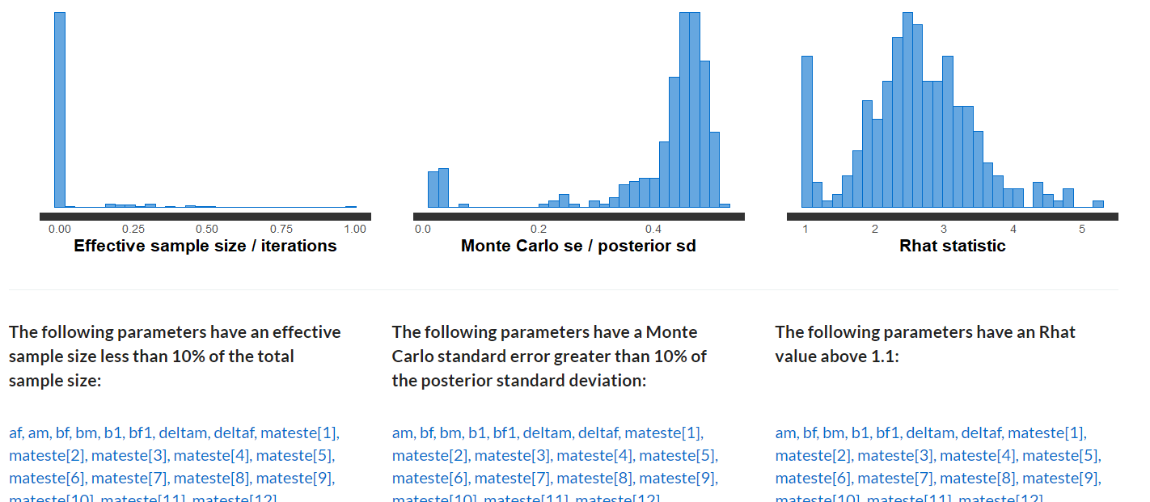
Snow crab – terrible despite thin=50
More thinning will not help!

Slide 19
Basic MCMC workflow with adnuts
Run as many RWM parallel chains as possible (<=8)
1000-2000 iterations, 10-25% warmup
Start with thin=1, increase until
Convergence diagnostics pass (ESS>200, Rhat<1.1)
or parameterization issues identified and resolved
Dispersed inits ideal, usually difficult with assessments (default is start at mode, read from admodel.hes).
https://mc-stan.org/users/interfaces/shinystan

Slide 20
[Share and discuss convergence diagnostics]

Slide 21
MCMC as a tool for “model diagnostics”
Passing convergence checks is mandatory before inference (minESS>200, max Rhat<1.1)
If checks fail despite increasing thinning,
Then slowest (or fastest) mixing parameters often coincide with model issues (pars w/ mode on bounds, inestimable, long tails, etc.)
Thus, examining failed MCMC convergence diagnostics is a useful method for model diagnostics

Slide 22
MCMC as a tool for model diagnostics
Why? Because default settings use the inverse Hessian (covar) as a tuning parameter (‘metric’ in adnuts).
When the covar approximates the posterior geometry well (‘matches’), it is more efficient
When not, it can be astonishingly inefficient
When the MLE and MCMC results are very different, something likely went wrong!

Slide 23
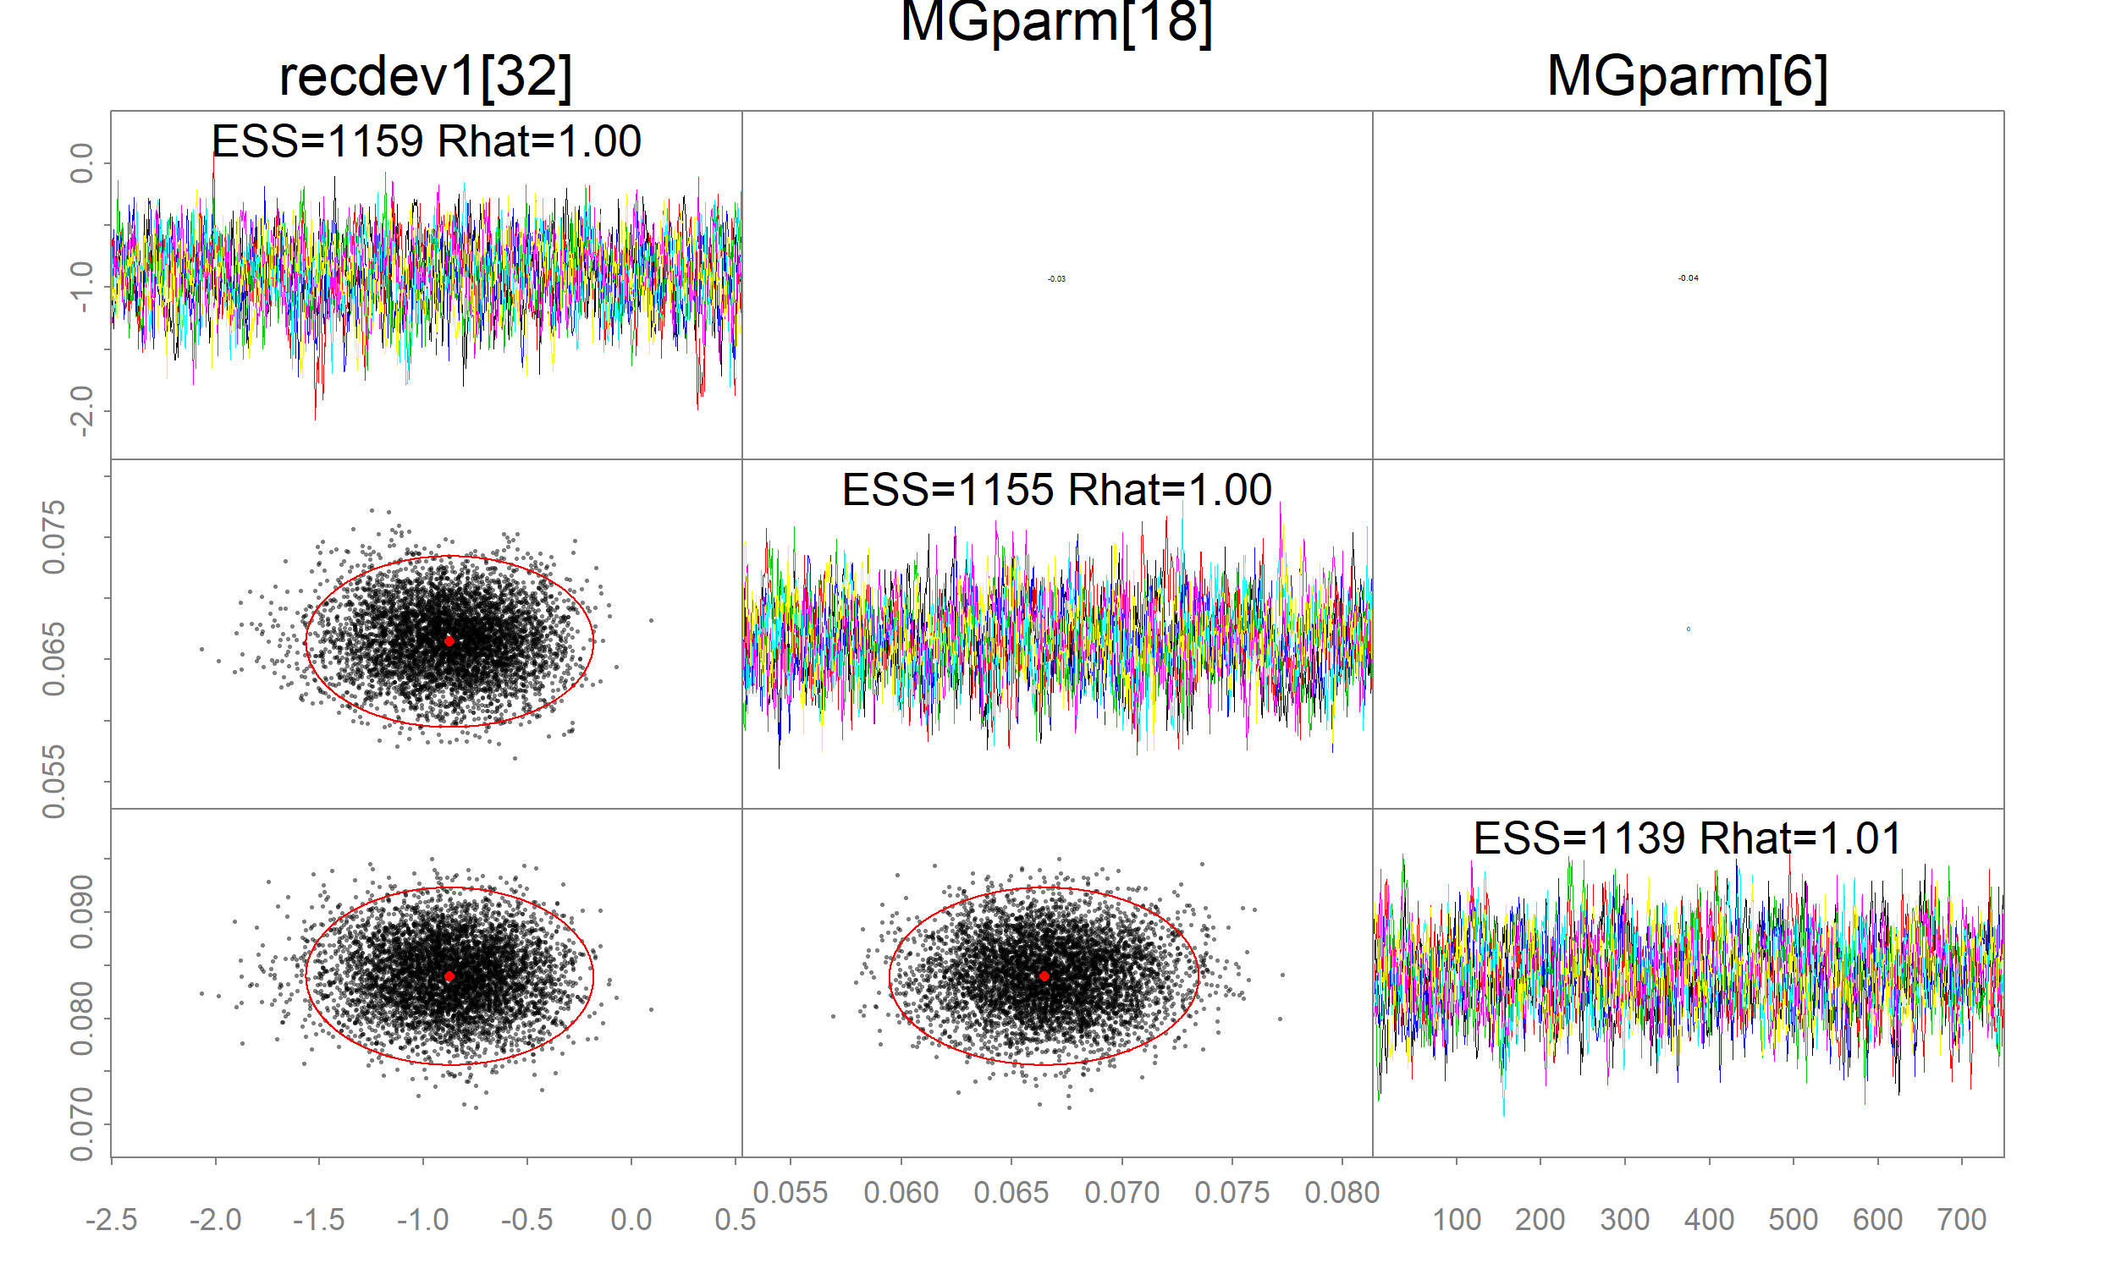
Model diagnostics: MCMC vs MLE for flathead
Three fastest pars
pairs_admb(fit, pars=1:3, order=fast')
Customized `pairs` plot for adnuts fits
Red ellipses=covar; black points=posterior
Looks great!

Slide 24
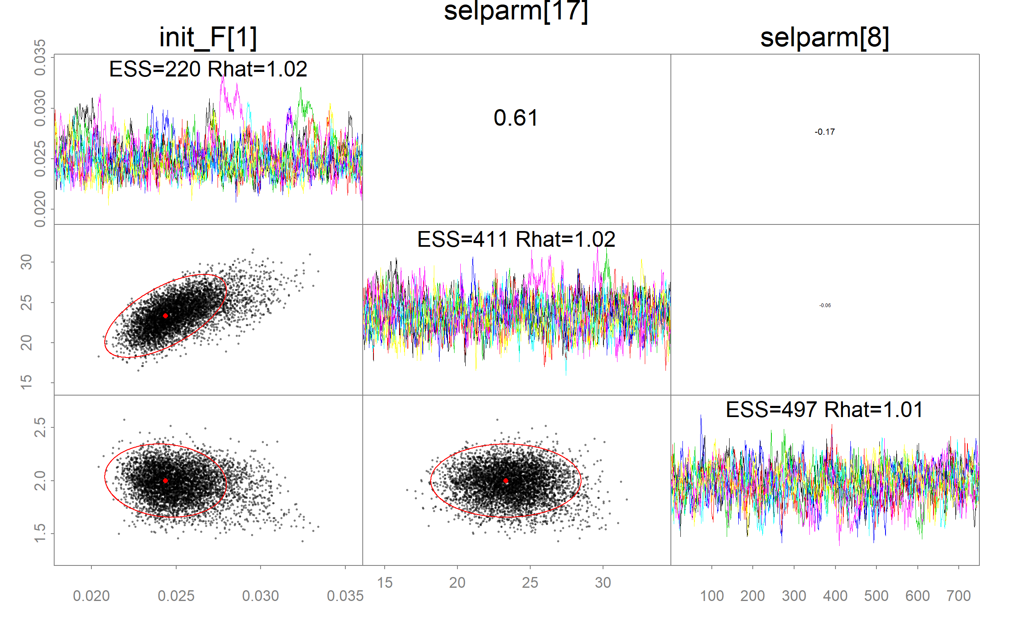
Model diagnostics: MCMC vs MLE for flathead
Three slowest pars
pairs_admb(fit, pars=1:3, order='slow')
… Still looks pretty good
There is no big mismatch here

Slide 25
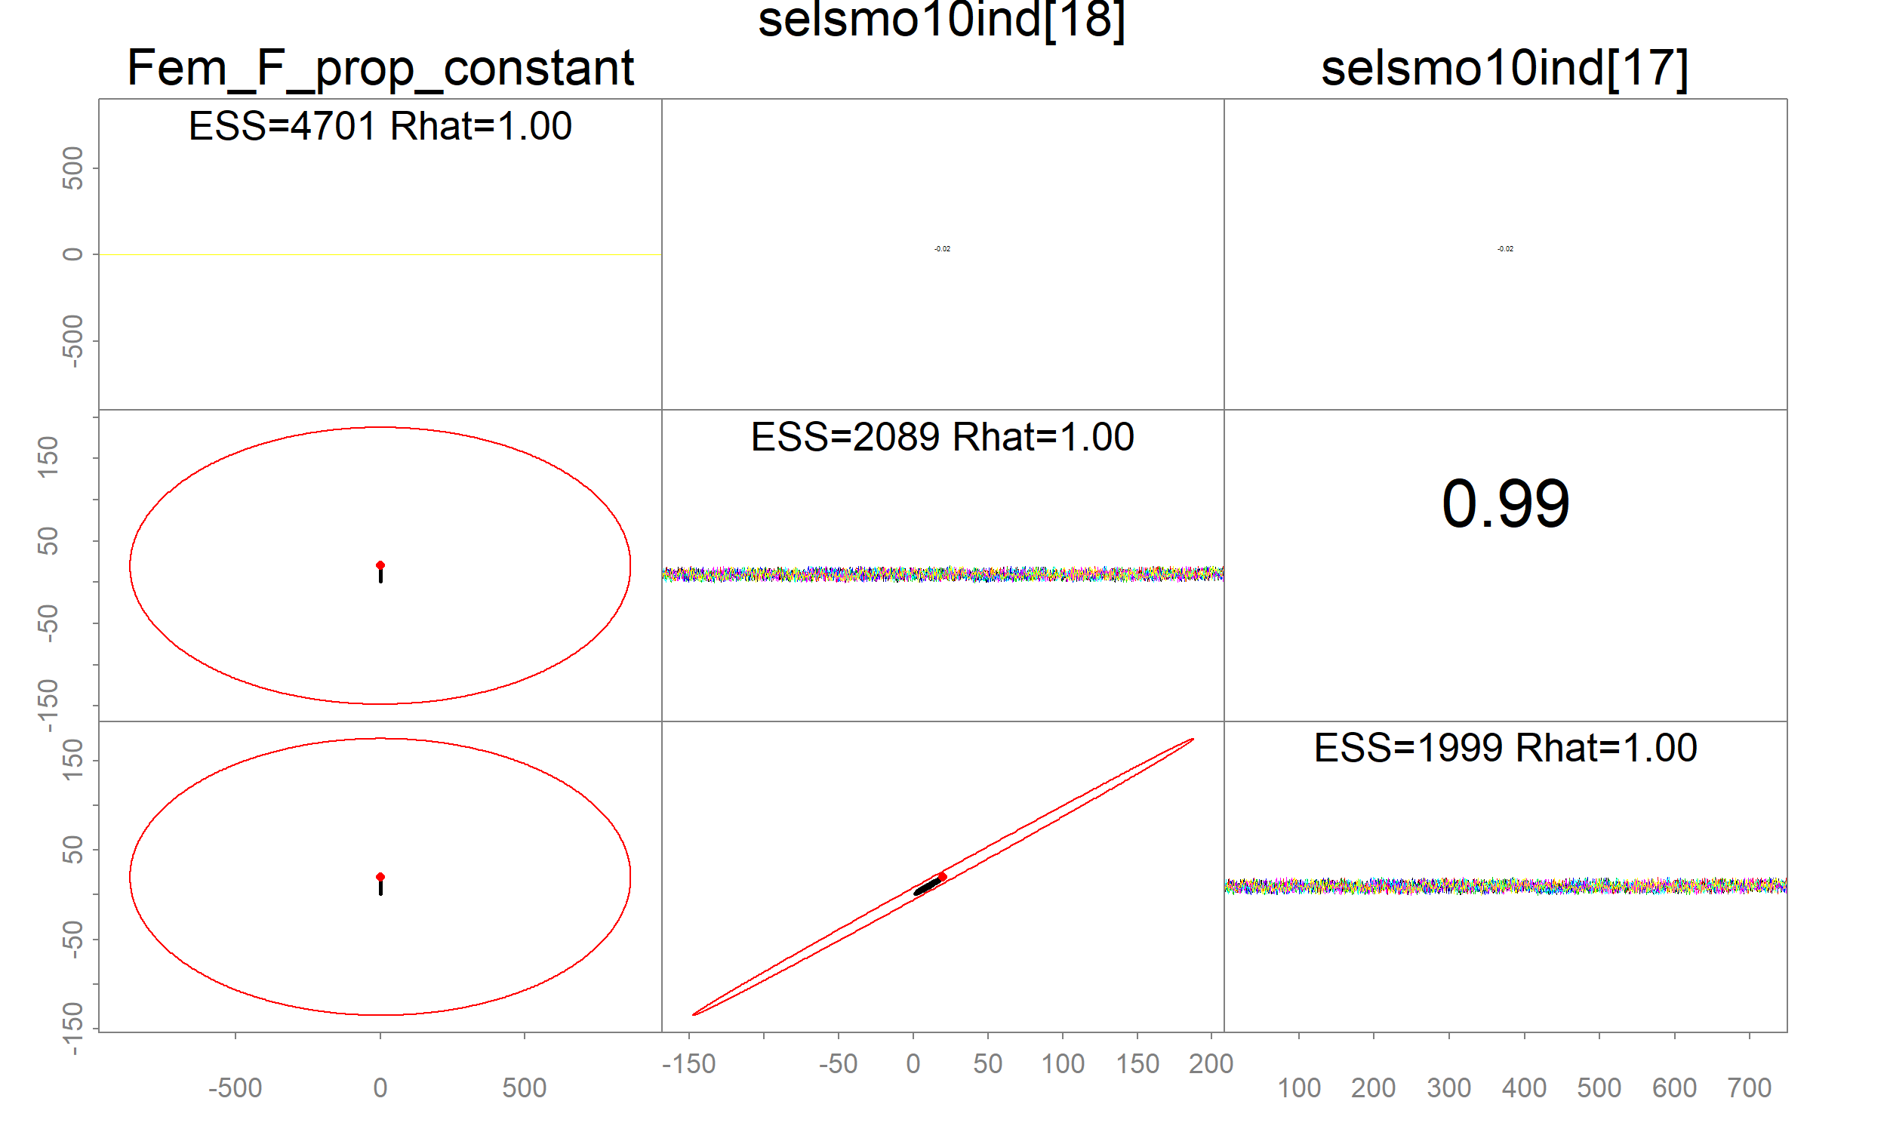
Model diagnostics: MCMC vs MLE for snowcrab
Three fastest pars
pairs_admb(fit, pars=1:3, order=‘fast')
What?
Look at the extreme nature of covar
It obscures the MCMC

Slide 26
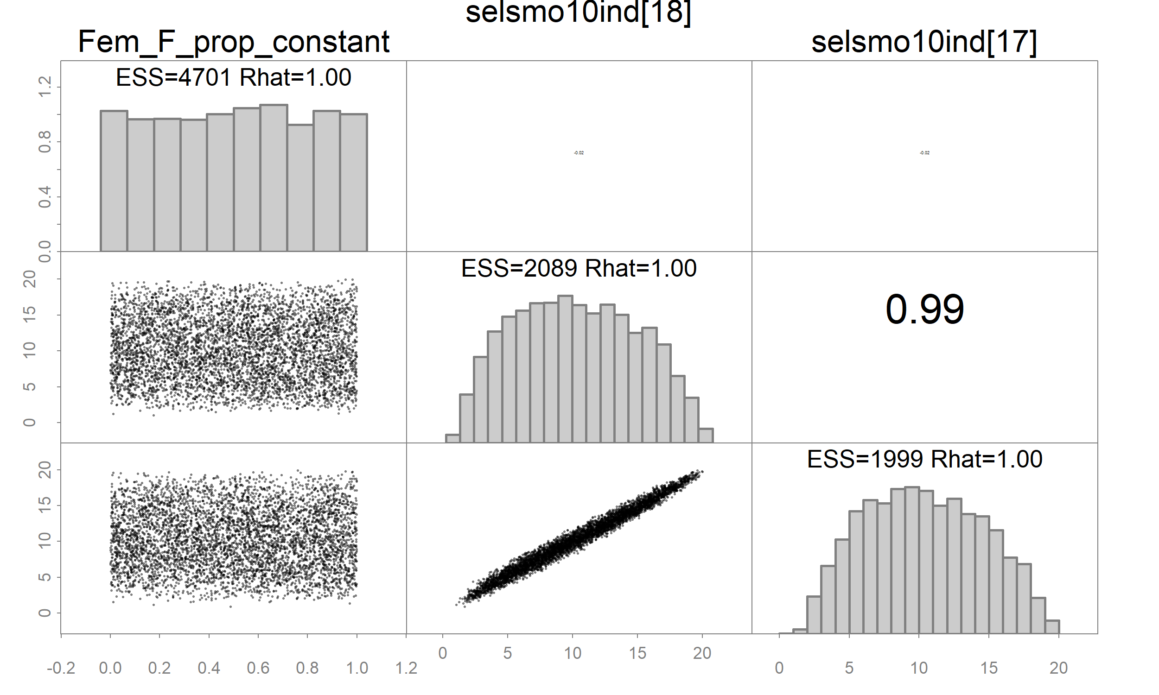
Model diagnostics: MCMC vs MLE for snowcrab
Three fastest pars
pairs_admb(fit, pars=1:3, order=fast‘,
add.mle=FALSE,
diag=‘hist’)
par #1 is uniform over it’s bounded range.
MLE estimate is N(0.5, 350^2)

Slide 27
Model diagnostics with MCMC
So what happened? Some SEs were enormously overestimated.
ADMB scaled *the whole* covar matrix down during tuning
Results in miniscule steps, extremely high autocorrelation
Ruins MCMC efficiency
But it helped identify model parameterization issues not readily apparent from MLE outputs

Slide 28
28
Snow crab
Thin=2; ESS=4; Rhat=3.6
Initialized at mode
Not converging to typical set
Thin=50; ESS=4; Rhat=3.7
Not at typical set!!

Slide 29
Model diagnostics: practical advantages
Validate the implicit asymptotic assumption: MVN(MLE, Covar)
Other parameterization issues often uncovered [show]
Fixing issues + regularizing key parameters can lead to massive speedups (Monnahan et al. 2019)
Examining MCMC output uncovers issues that often should be addressed for MLE models as well
I argue this makes for more robust, stable frequentist models

Slide 30
[Share/discuss individual model diagnostics]

Slide 31
Model inference with adnuts
Once MCMC is converged, can use posterior samples for inference
Optional mceval=TRUE argument executes afterward on merged chains (or use command line)
ShinyStan useful for quick look, visually or tabular, including exporting LaTeX tables

Slide 32
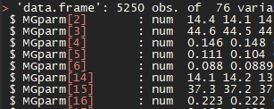
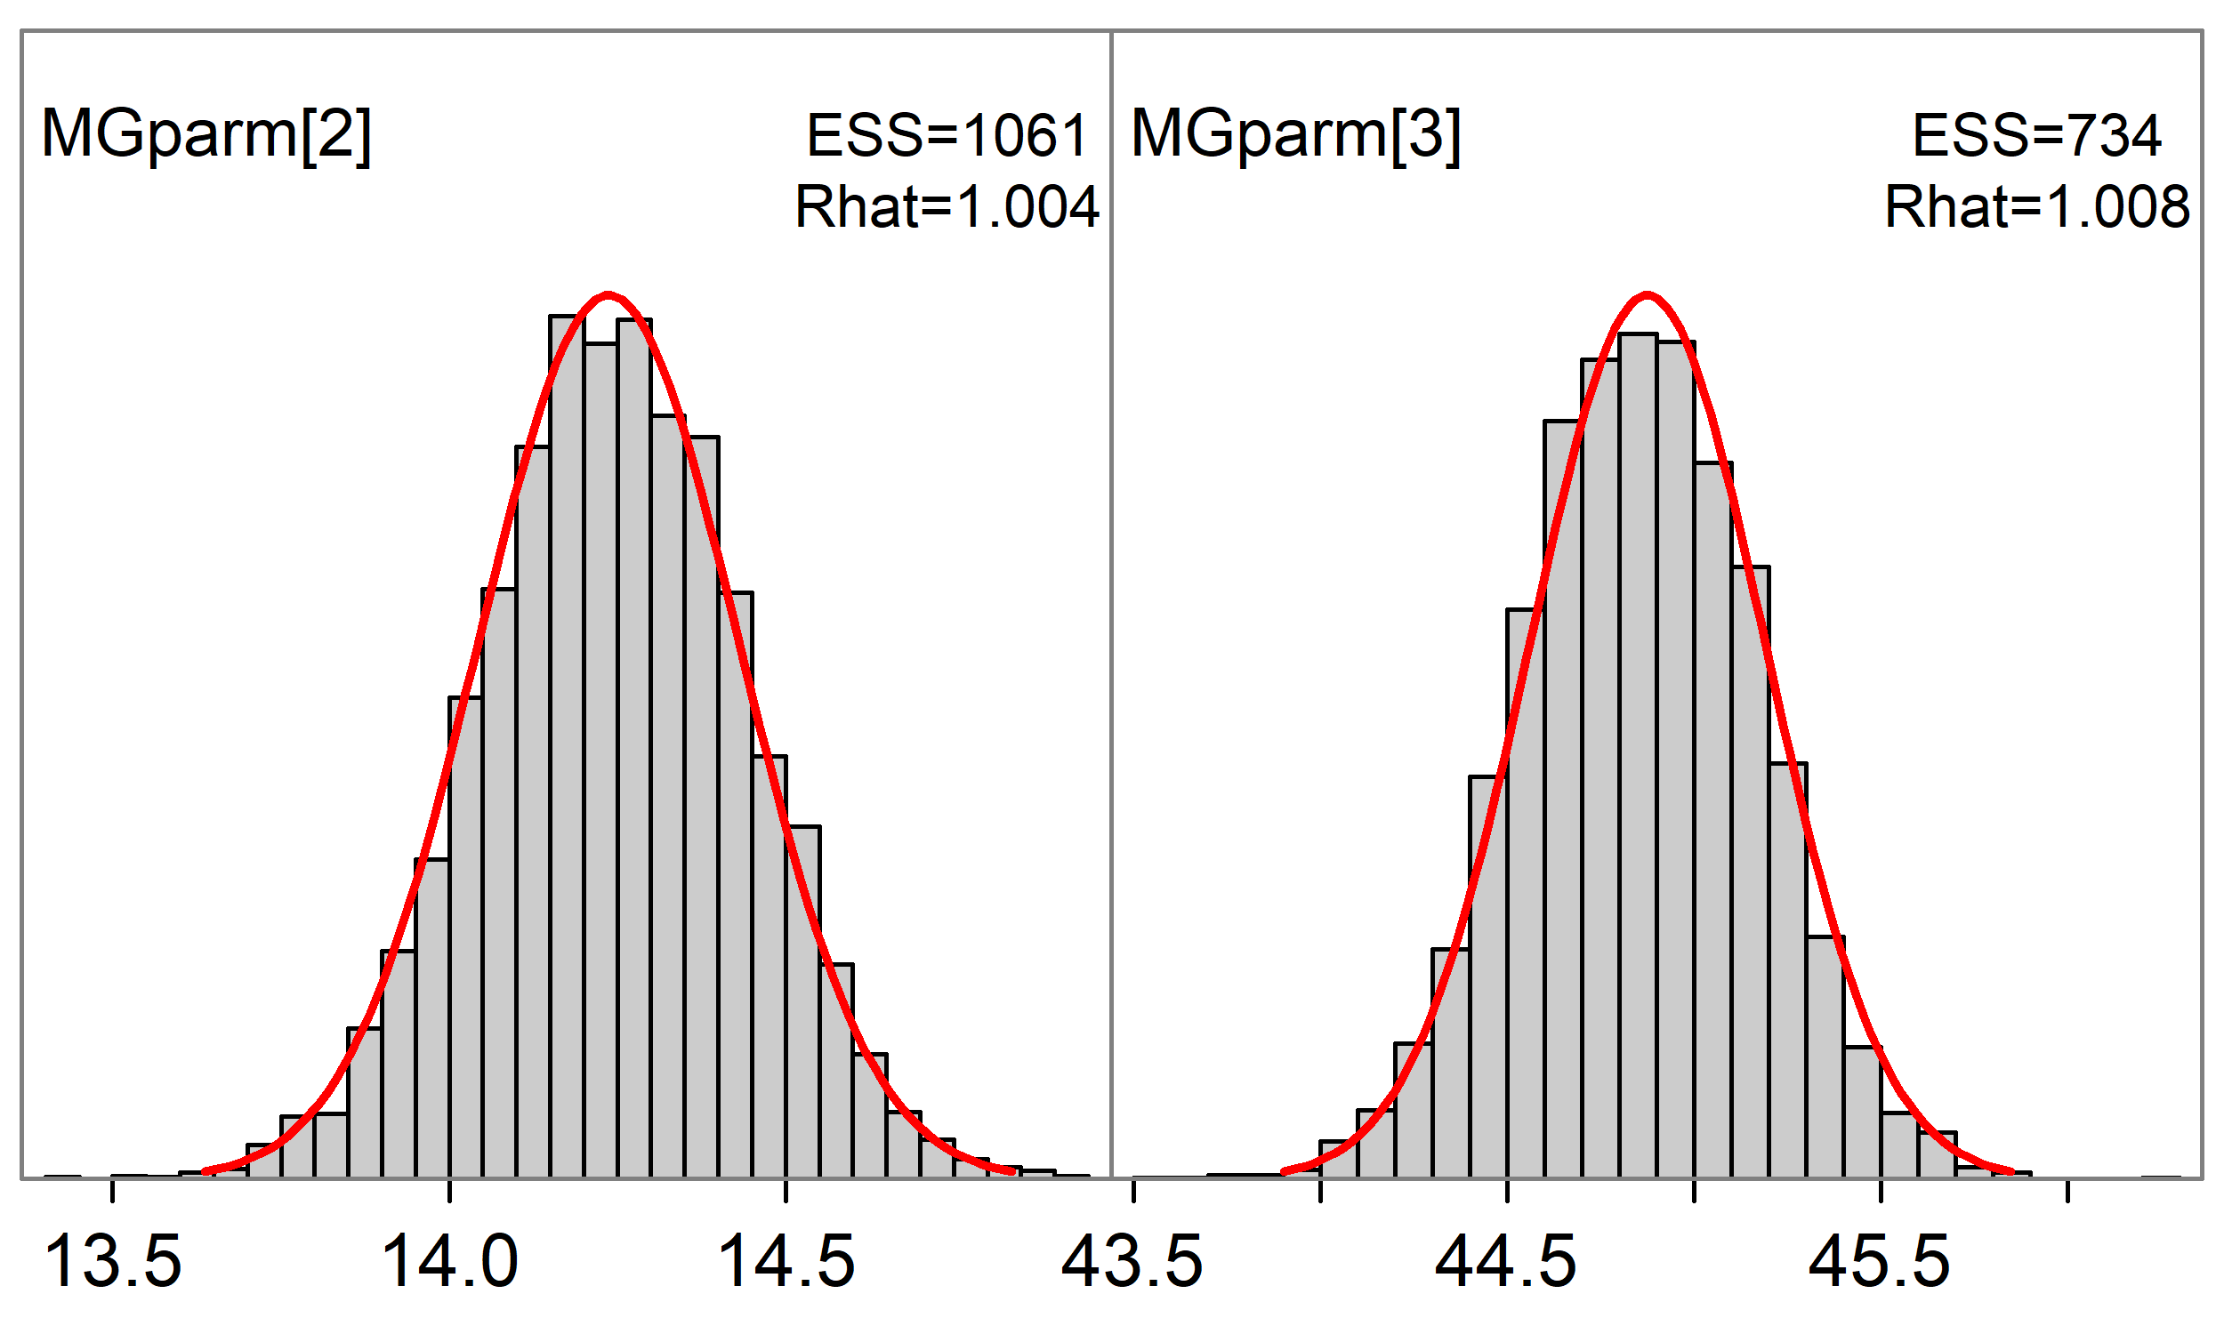
Model inference with adnuts
Posterior as data.frame: post=extract_samples(fit)
Marginal histograms: plot_marginal(fit, pars=1:2)
Lots of options for extensions

Slide 33
Conclusions on basic workflow
Prior specification, prior predictive, posterior predictive, model validation etc. not covered here but important
RWM chains are
Sufficient for most well-parameterized models
Useful for diagnosing parameterization issues
Useful for checking frequentist assumptions (i.e., N(MLE, Covar) )
Regularization -> more robust frequentist models
You cannot thin your way out of a poorly parameterized model!
(N.B. thinning discards information, is only used to reduce memory and calcs)

Slide 34
Conclusions on basic workflow
‘One long vs. many short’: it is (now) trivial to run parallel long chains!
Many well-parameterized models should run < 1 hr
An invertible Hessian is not sufficient evidence of:
Reliable standard errors, asymptotic assumptions met, optimizer convergence
Note: there is a bug with dev_vector types, best to avoid (link)
Please report issues/feedback to: https://github.com/Cole-Monnahan-NOAA/adnuts/issues

Slide 35
Thoughts on advanced workflow
RWM requires a reasonable Covar, which will not exist for hierarchical models
NUTS algorithm is ideal for this and available in same workflow (Monnahan et al. 2017; Monnahan & Kristensen 2018)
In theory multiple hypervariances estimable simultaneously, but untested for SCAA models
… Part of ongoing research, and maybe future workshops!
NUTS typically does worse in face of bad parameterization issues

Slide 36
References & further information
Monnahan, C. C., Branch, T. A., Thorson, J. T., Stewart, I. J., and Szuwalski, C. S. 2019. Overcoming long Bayesian run times in integrated fisheries stock assessments. ICES Journal of Marine Science. 10.1093/icesjms/fsz059.
Monnahan, C. C. and K. Kristensen. 2018. No-U-turn sampling for fast Bayesian inference in ADMB and TMB: Introducing the adnuts and tmbstan R packages. PLOS One 13:e0197954.
Monnahan, C. C., J. T. Thorson, and T. A. Branch. 2017. Faster estimation of Bayesian models in ecology using Hamiltonian Monte Carlo. Methods in Ecology and Evolution 8:339-348.
‘adnuts’ documentation:
vignette(‘adnuts’)
https://github.com/Cole-Monnahan-NOAA/adnuts/blob/master/inst/demo.R
‘Stan’ documentation and information:
https://mc-stan.org/users/documentation/

Slide 37
References & further information
Monnahan, C. C., Branch, T. A., Thorson, J. T., Stewart, I. J., and Szuwalski, C. S. 2019. Overcoming long Bayesian run times in integrated fisheries stock assessments. ICES Journal of Marine Science. 10.1093/icesjms/fsz059.
Monnahan, C. C. and K. Kristensen. 2018. No-U-turn sampling for fast Bayesian inference in ADMB and TMB: Introducing the adnuts and tmbstan R packages. PLOS One 13:e0197954.
Monnahan, C. C., J. T. Thorson, and T. A. Branch. 2017. Faster estimation of Bayesian models in ecology using Hamiltonian Monte Carlo. Methods in Ecology and Evolution 8:339-348.
‘adnuts’ documentation:
vignette(‘adnuts’)
https://github.com/Cole-Monnahan-NOAA/adnuts/blob/master/inst/demo.R
‘Stan’ documentation and information:
https://mc-stan.org/users/documentation/

